Slide 1
Intermediate programming
Session 06
ICT40220 Certificate IV in Information Technology (Programming)
Cluster: Intermediate programming and open source (IPOS)
ICTPRG439 | Use pre-existing components
ICTPRG429 | Maintain open-source code programs
ICTPRG443 | Apply intermediate programming skills in different languages

Slide 2
Last week
In looking at binary files and random access we started noting the importance of data structures
Data structures apply not just to how data is stored on disk but more importantly how data is stored in memory
Just like binary is usually abstracted, so are data structures

Slide 3
Data structures and binary search
Now…

Slide 4
Objectives
Understand fundamental data structures in computer science
Relate these core data structures to Python builtins and standard library structures
Identify and apply key properties of these core data structures
Implement binary search techniques and define log n time complexity
Apply these standard data structure to real-world use cases

Slide 5
Data Structures
How we think about data structures in Python:
lists, tuples, dictionaries, sets, classes
What data structures are:
A formal way of aggregating information as a single structure
Lists, tuples, dictionaries, sets, classes, are examples of abstractions
Of what? Algorithms for traversing memory addresses and data associated with those addresses

Slide 6
Data Structures: definition
“A data structure is a specialised format for organising and storing data in a computer such that it can be accessed and modified efficiently. ”

Slide 7
Data Structures: definition
Efficiency?
Specialised?

Slide 8
Data Structures: Analogy
Bookshelf: Great for accessing any book but adding a new book in the middle is tricky.
Stack of plates: Easy to add or remove from the top, but accessing a plate in the middle requires moving others.
Queue at the shops: People join at the end and leave from the front.
Notes:
"Think of a data structure as a specific type of storage facility. Different storage facilities serve different needs, and no one type is perfect for every kind of storage."

Slide 9
Discussion Activity
Think of your own real-world scenarios for the following:
Insert an item at one end and remove from the other.
Insert from one end remove from the same end
Make it easy to insert items in random positions or remove from specified positions (without reshuffling everything)
Notes:
Add items to the end:
Scenario: Think of a concert where fans line up to get tickets. New fans join at the end of the line.
Discussion Prompt: Why is it important for fans not to cut in the middle or start of the line?
Add items to the beginning:
Scenario: In some emergency situations, critical patients in a hospital are given priority and are attended to before others.
Discussion Prompt: Why might it be crucial to attend to some patients first, even if others arrived earlier?
Randomly access an arbitrary position:
Scenario: In a parking lot, you can drive directly to any parking spot without moving the other cars.
Discussion Prompt: Why is direct access beneficial in a parking scenario?

Slide 10
Python and data structures
Data is fundamental to programming and therefore data structures are fundamental
In Python we encounter data structures using high-level abstraction of the various collection types: lists, tuples, dict, sets, etc.
Even classes, as we’ll soon see, are data types

Slide 11
High Level Abstraction in Python
data structures are hidden from us in Python’s C implementation
pop & append operations are implemented in C using the CPython interpreter.
# Append an element to the list
some_list.append(6)
# Pop the last element from the list
popped_element = some_list.pop()
# Access an element by index
first_element = some_list[0]

Slide 12
So, why should you care?
So why should you care?
Notes:
“why should I care?” when you are intending to program in a high-level language is a reasonable question.
you seldom need to define these data structures yourself,
because most core data structures are implemented in C they will usually be significantly faster than anything you write in Python,
even if they are not specialised or optimised for your application.

Slide 13
Why bother
Develop accurate mental models of abstractions
Predict the benefits and limitations of abstractions
Gateway to lower-level languages and polygloting in general
Technical interview questions
Identify patterns other programmers code or languages
Also, part of the UoC 🤷
Notes:
Mental Models & Predictive Power: By understanding the underlying mechanics of data structures, developers can form accurate mental models. This aids them in predicting the behaviours, efficiencies, and possible issues arising from using these structures. For example, understanding why dictionary key lookups are fast can help a developer make design choices that leverage this speed.
Understanding Benefits & Limitations: Without a foundational understanding, we may misuse or overuse certain data structures. Knowing the strengths and weaknesses of each structure helps in picking the right tool for the task. For example, while lists in Python are versatile, they might not be the best choice for ensuring unique elements or rapid membership tests, unlike sets.
Gateway to Lower-Level Languages: A solid grasp of data structures isn't just valuable for Python, but for programming as a whole. If a developer decides to delve into lower-level languages like C or C++, where memory management is crucial and data structures aren't as abstracted, this knowledge becomes invaluable. This transition becomes smoother with an understanding of the core concepts.
Technical Interviews & Beyond: Many tech companies still gauge a candidate's understanding of data structures and algorithms during interviews. But beyond just landing a job, this understanding can be a talking point during architectural decisions or when contributing to open-source projects where performance and optimisation discussions are common.
Broadening the Development Mindset: Beyond practical applications, understanding data structures and their mechanics can shape the way developers approach problems. It cultivates a mindset of optimisation, efficiency, and clarity, essential traits in software development.
Cross-Language Versatility: Python is just one of many languages a developer might encounter or need. When transitioning to or working with another language, foundational knowledge of data structures ensures they aren't starting from scratch.

Slide 14
Key data structures
Deep dive

Slide 15
Key data structures
Data Structure | Description | Common Operations | Python Representation
List | An ordered collection of items which can be of any type. | Add, Remove, Search, Iterate | list()
Array | A collection of elements identified by index or key. Usually fixed in size. | Read, Insert, Delete, Search | Array module
Linked List | Collection of nodes where each node contains a data field and a reference(link) to the next node in the sequence. | Insertion, Deletion, Traversal | Custom classes
Stack | A LIFO (Last In First Out) structure. Think of it like a stack of plates. | Push, Pop, Peek/Top | list() with append() and pop()
Queue | A FIFO (First In First Out) structure. Think of it like a line of people waiting. | Enqueue, Dequeue, Peek | collections.deque()
Notes:
Note to students that LIFO is the same as FILO and FIFO is the same as LILO

Slide 16
Key data structures (cont.)
Data Structure | Description | Common Operations | Python Representation
Trees | A hierarchical structure with a root element and subtrees of children. | Insertion, Deletion, Traversal | Custom classes or libraries like anytree
Graphs | A collection of nodes with edges between (some of) them. | Add Vertex, Add Edge, Search | Custom classes or libraries like networkx
Sets | An unordered collection of unique elements. | Add, Remove, Union, Intersection | set()
Hash Tables | Key-value pairs where keys are unique. Offers rapid data retrieval. | Insert, Delete, Retrieve by Key | dict()
Binary Search Tree | A tree in which for each node, all elements in the left subtree are less than the node, and all elements in the right subtree are greater than the node. | Insert, Delete, Search | Custom classes or libraries
Notes:
Highly recommended channel that will cover many of these data structures in much more detail than we can afford to: https://www.youtube.com/watch?v=cOfhwxirhUE
https://www.youtube.com/watch?v=ItjAF6et-mQ
Trees are graphs, graphs can have a number to signify direction, weight or both in a relationship

Slide 17
Primitive & Non-primitive types
Primitive
stored directly in memory
often immutable
simple values
used for basic data storage
Non-primitive
stored indirectly using references or pointers.
can be mutable/immutable.
represent more complex data structures.
used for complex structures, algorithms & classes.

Slide 18
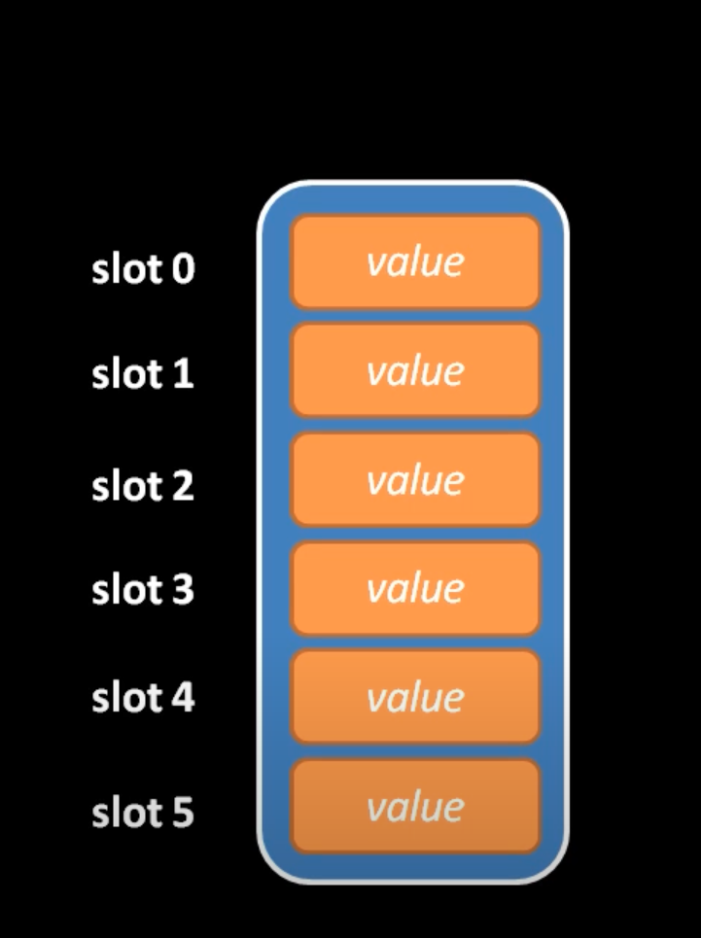
List & Arrays
from array import array as arr
# Homogeneous array of integers
int_array = arr('i', [1, 2, 3, 4, 5])
# Heterogeneous list
mixed_list = [1, 'two', 3.0, [4, 5]]
# You cannot do this
array_mixed_list = arr('i', [1, 'two', 3.0, [4, 5]])
# TypeError: 'str' object cannot be interpreted as an integer
https://www.youtube.com/watch?v=cOfhwxirhUE
Notes:
array Format Specifiers
The array module defines sequences of uniform type, with supported types and their format codes as follows:
Reference: Python's array documentation

Slide 19
Lists and Arrays
”Lists” are an abstraction of the Array as a data structure
Python list: list(), []
Python array: from array import array (one of the few ways to create primitives/values in Python!!)
Notes:
array Format Specifiers
The array module defines sequences of uniform type, with supported types and their format codes as follows:
Reference: Python's array documentation

Slide 20
Memory Usage
Arrays - elements are stored in a contiguous block of memory, with a fixed size & the same data type.
Lists - elements are stored as references to objects in memory. This reference object can be any data type. List can be larger than needed.
Notes:
Arrays (Similar to that of primitive types – integers, Booleans etc..)

Slide 21
Efficiency
Arrays - homogenous nature allows arrays to be more memory efficient and faster since they have a fixed size and type.
Lists - mixed types provide flexibility but are less memory efficient and slower since they contain various sizes & types of object.
**Both maintain their order when an action is taken.

Slide 22
from array import array
so_primitive = array('i', [1, 2, 3, 4, 5]) # must include a format specifier # foundation of numpy arrays!
Code | C Type | Python Type | bytes
'b' | signed char | int | 1
'B' | unsigned char | int | 1
'u' | Py_UNICODE | Unicode character | 2
'h' | signed short | int | 2
'H' | unsigned short | int | 2
'i' | signed int | int | 2
'I' | unsigned int | int | 2
'l' | signed long | int | 4
'L' | unsigned long | int | 4
'q' | signed long long | int | 8
'Q' | unsigned long long | int | 8
'f' | float | float | 4
'd' | double | float | 8

Slide 23
Measuring Time
As programs become more complex the amount of time an algorithm takes to complete can become unknown and therefore a problem.
we use Big O notation to evaluate work done.
describes the time as worst-case scenario.
Notes:
Review big_o.py

Slide 24
Constant time – O(1)
the time taken to access an element at a specific index is independent of the size of the collection.
suitable for scenarios where frequent random access to elements is required, e.g. searching or iteration
https://learning.oreilly.com/library/view/grokking-algorithms

Slide 25
Linear time – O(n)
the time taken to action an element & is dependent on the size of the collection.
suitable for scenarios where items are placed or removed, e.g. insertion or deletion
https://learning.oreilly.com/library/view/grokking-algorithms
Notes:
Review big_o.py

Slide 26
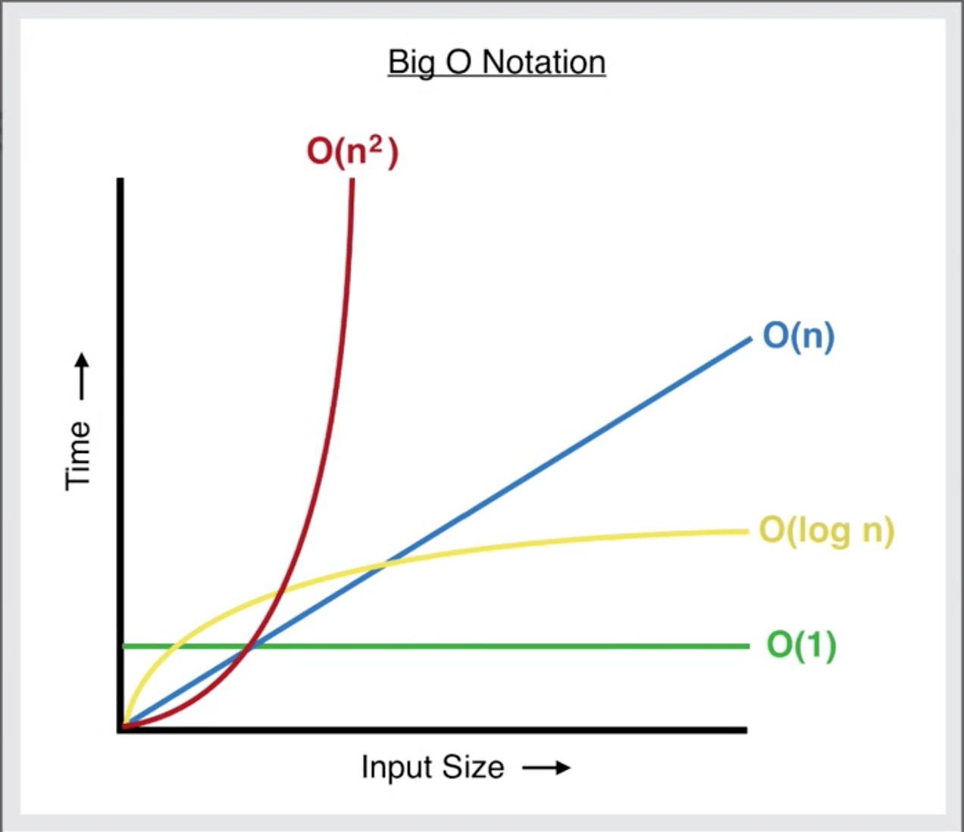
Work Done & Growth
We are measuring the growth in work that the computer needs to do to complete the task
How To Calculate Time Complexity With Big O Notation | by Maxwell Harvey Croy | DataSeries | Medium
Notes:
Review big_o.py

Slide 27
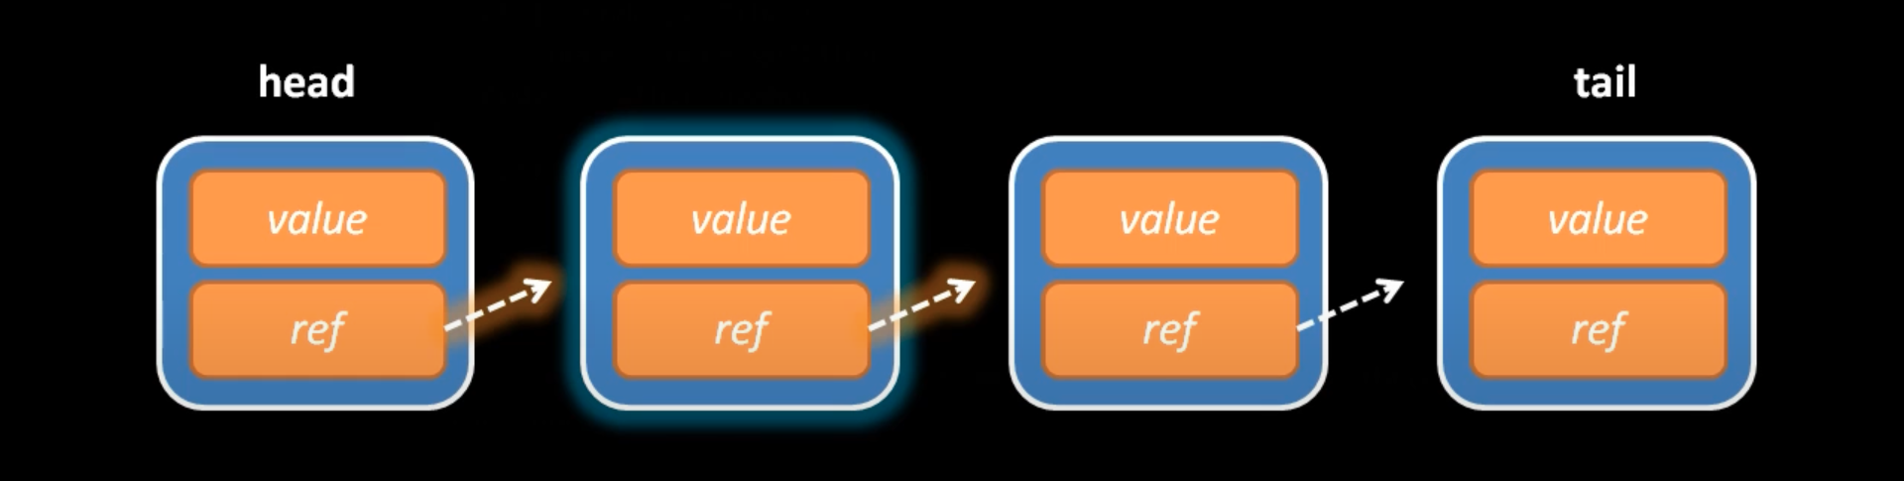
Linked Lists
https://www.youtube.com/watch?v=cOfhwxirhUE
Notes:
Linked lists differ from arrays by their storage:
elements can be anywhere in memory, connected by pointers.
Each node contains the data and a reference to the next node.

Slide 28
Linked Lists
The gateway drug into data structures
Consists of nodes: data and references
Single: nodes only point forward
Double: nodes point forward and backwards
Notes:
Lecturer notes – open and step through linked_lists.py

Slide 29
Queues and stacks
Collection types - Last In First Out (LIFO) and First In First Out (FIFO (not ‘works in the mines’)
Python: collections.deque (pronounced DECK): A double-ended queue

Slide 30
Stacks - LIFO
Used in managing function calls in recursion
append() adds an element to the top of the stack,
pop() removes & returns the top element from the stack.
use the collections.deque class which provides add/remove operations.
def push(self, item):
# Add an item to the top of the stack
self.stack.append(item)
def pop(self):
if not self.is_empty():
# Remove and return the top item
return self.stack.pop()
else:
# Return None if the stack is empty
return None

Slide 31
Queues - FIFO
managing resources, like CPU scheduling & handling requests.
we can use the queue module in the standard library
provides a FIFO queue using put() - enqueue & get() - dequeue.
using the lists append() & popleft() methods
def enqueue(self, item):
self.queue.append(item)
def dequeue(self):
if not self.is_empty():
return self.queue.popleft()
else:
return None

Slide 32
Activities 1 & 2
Notes:
Discuss what use cases can we think of for stacks and queues

Slide 33
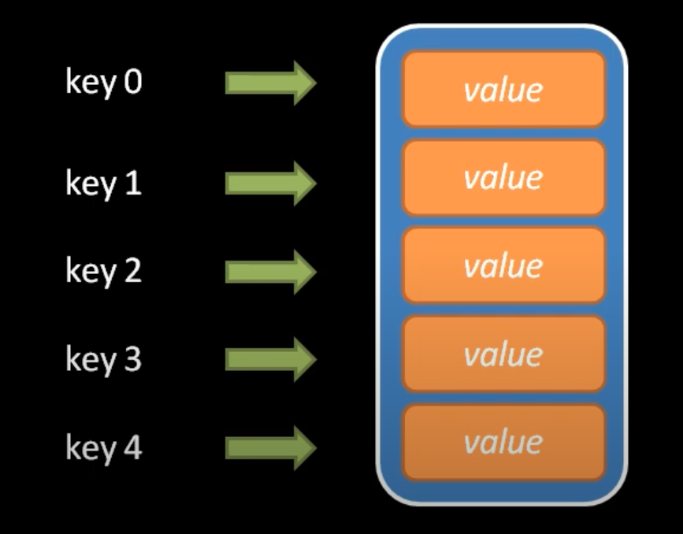
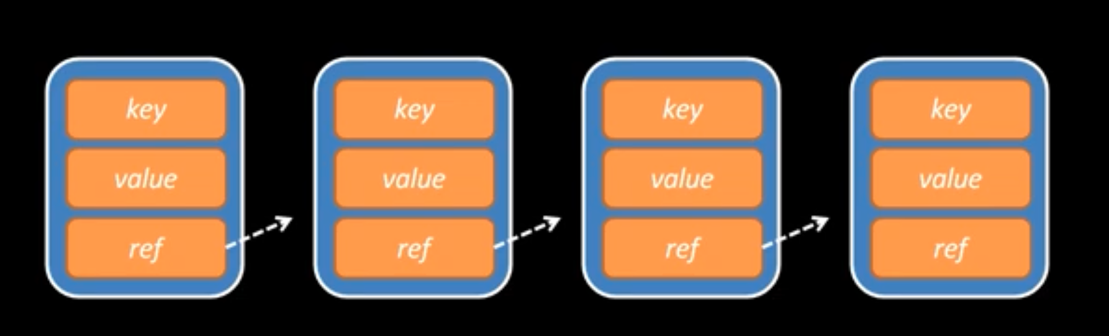
Maps & Associative Arrays
We create structures to hold values for retrieval using keys
https://www.youtube.com/watch?v=ItjAF6et-mQ

Slide 34
Consider
How do we get the efficiency of a list/array but we use the keys given to us in the array?
Notes:
Hashmap (Dictionary) of keys to values
Dictionary of lists
List of Tuples

Slide 35
Consider
Hashmap: (Dictionary) of keys to values
Dictionary of lists
List of Tuples
Which is faster?
Notes:
Students may consider how Pandas and python OrderedDictionary collections can improve efficiency as the data scales up.

Slide 36
Hash Functions
Dictionaries and sets use hashing
Think array, with the added feature of distilling a key to a number representing the position of a value.
def simple_hash(name):
hash_value = 0
for character in name:
hash_value += ord(character)
return hash_value % 10
# Example usage
print(simple_hash("Ahmed")) # Output: 3
print(simple_hash("Smith")) # Output: 0
Notes:
Introduction:
Hash tables are data structures that enable efficient data retrieval and storage.
In Python, dictionaries and sets are implemented using hash tables.
Basics of Hash Table:
Consists of an array and a hash function.
Hash function converts a given key into an index in the array where the value is stored.
Role in Python:
Dictionaries use hash tables to map keys to values.
Sets use hash tables to store unique elements.
Array and Hashing:
Unlike a simple array, a hash table uses the hash function to determine the index position for each key.
This allows for constant time for add, delete, and search operations, assuming a good hash function and uniform distribution.

Slide 37
“Ahmed”
0
0
“Anna”
1
“Bob”
Hash Function
2
3
“John”
“Smith”
4
4
Hash Function
User number to lookup or insert value in array
Notes:
Review simple hash example

Slide 38
Hash Functions
simple hash functions values can be hashed to the same key
this is referred to as a hash collision
we need to find the next available slot in the table
if the allocated table(memory) is full, python resizes the table*
in memory this can also involve creating a linked list or tree of connected memory addresses
Notes:
Python will often double the memory size of the table, array or list – review simple_hash & hash_table examples

Slide 39
Closed Hashing Animation using Open Addressing

Slide 40
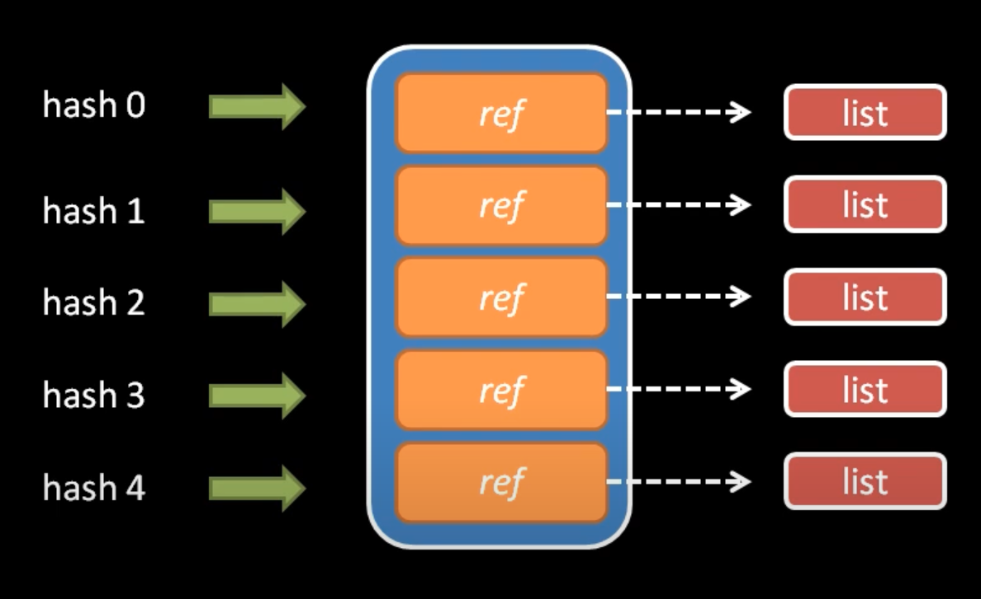
Hash Tables and Scaling up
If we want to store multiple values and related keys, how can we achieve this?
By using a hash table and chaining
simple hash functions values can be hashed to the same key
Notes:
Review hash table example

Slide 41
Graphs and Trees
Where angels fear to tread…
Essential for all advanced applications
Form the base for Large Language Models(AI)
Git, Google Maps, and a whole stack of leet code questions all boil down to them

Slide 42
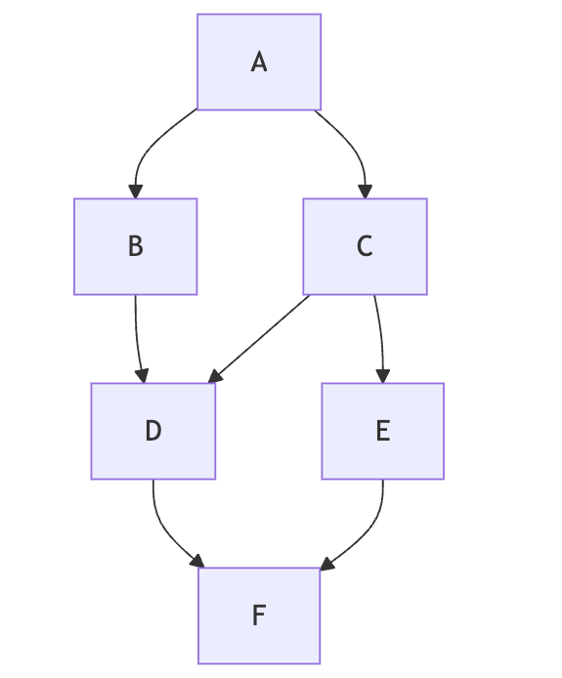
Graphs
model relationships between objects.
nodes(vertices) represent objects, edges (arrows) represent relationships between the nodes
relationships can be:
undirected (two-way)
directed (one-way).
weighted
What relationships might be represented by weights?
Notes:
Directed can be considered a Parent – Child
Use case for calculating optimum travel routes

Slide 43
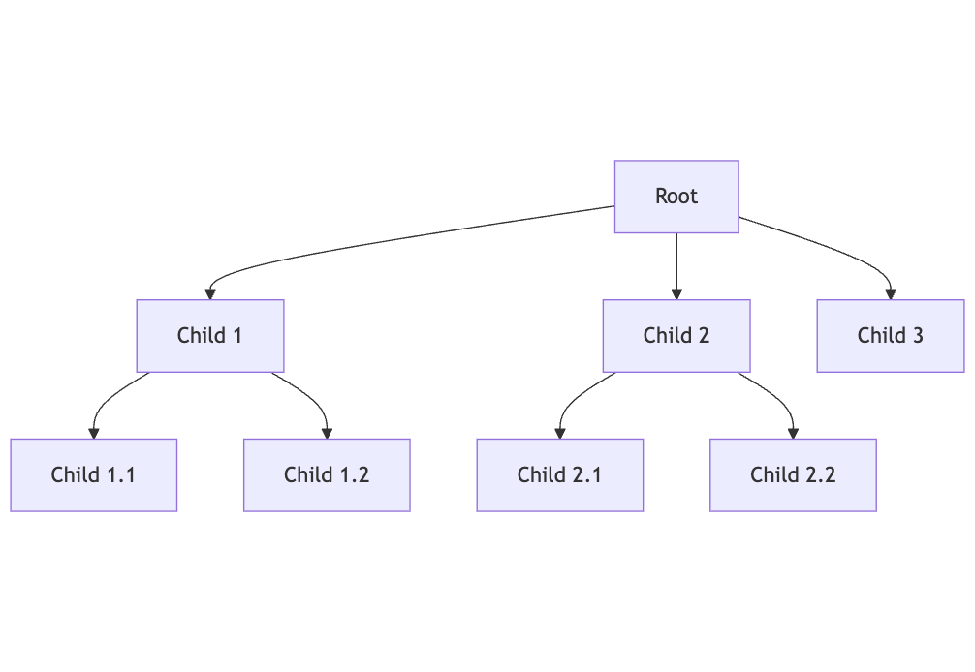
Trees (aka Graphs with a root)
they represent hierarchical relationships and structures.
binary trees are a subset where each node no more than two children
form the basis for more advanced structures and algorithms
Notes:
Use case these binary trees can indicate everything to the left of a node being of a lower value binary searching

Slide 44
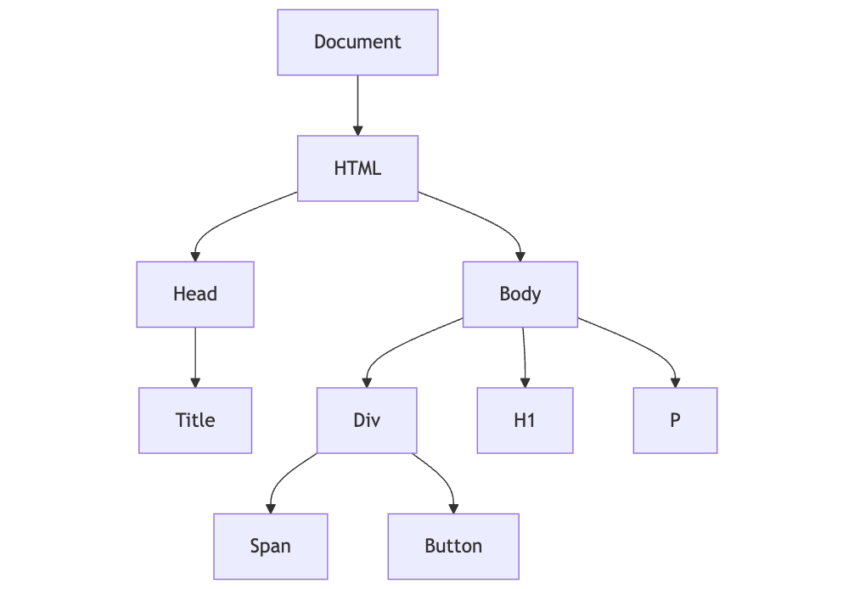
A Tree in the wild – The DOM Tree
Notes:
Used in Javascript, React etc…..
Review animation at https://www.cs.usfca.edu/~galles/visualization/ComparisonSort.html

Slide 45
Python: User data structures examples
Classes
Dataclasses
Named Tuples

Slide 46
Data Classes
have a fixed set of attributes
created using the@dataclass decorator, which adds special methods
attributes are declared in the class definition (incl. type)
they can be made immutable by adding the frozen=True.
from dataclasses import dataclass
@dataclass
class Coordinates:
latitude: float
longitude: float frozen
coordinates = Coordinates(latitude=37.7749, longitude=-122.4194)

Slide 47
Activity 3

Slide 48
Binary Search
algorithm for finding values in a sorted list
your first divide and conquer algorithm!
O(log n) average/worst-case time complexity
Scenario: we can only go out when it 19 degrees lets find the time of day when we can go out
Remember our binary tree structure….
Notes:
Binary search repeatedly divides the search interval in half, a quintessential divide and conquer strategy.
Offers significant speed advantages over linear search, especially for large datasets.
Key requirement: the list or array must be sorted.
Review binary search example

Slide 49
Binary Search Animation
Binary Search Tree Animation
Notes:
Binary search repeatedly divides the search interval in half, a quintessential divide and conquer strategy.
Offers significant speed advantages over linear search, especially for large datasets.
Key requirement: the list or array must be sorted.

Slide 50
Python sorting
sorted() function: Returns a new sorted list
list.sort() method: Sorts the list in place
bisect.bisect (binary search module)
Note: native C will beat most algorithms for real-world applications

Slide 51
Bubble sorting
compares adjacent elements
swaps them if they are in the wrong order.
use case: small datasets
does not require additional memory
O(n²) in the worst case

Slide 52
Insertion sorting
builds a sorted array one item at a time
use case: small datasets
uses a small amount of memory
O(n²) in the worst case

Slide 53
Selection sorting
selects the lowest value item from the unsorted part
swaps with the first unsorted element.
inefficient but simple
does not require additional memory
may not keep original order of equal elements
O(n²) in all cases

Slide 54
Merge sorting
splits an array into 2 & merges sorted halves - recursively
use case: large datasets
requires additional memory for the merging process
O(n log n) in all cases

Slide 55
Quick sorting
selects an element and splits the array in 2 sorts the halves - recursively
use case: large datasets
requires only a small amount of memory.
may not keep original order of equal elements
O(n²) in the worst case

Slide 56
Work on KBA 1
KBA AND NEXT WEEK…

Slide 57
Next
Now that we have refined our foundational knowledge of Python, we have enough tools to get into trouble
Next week, we turn our attention to debugging and documentation.
We will also use this to understand modern processes of quality control and document generation

